Slide 1
S J C INSTITUTE OF TECHNOLOGY
DEPARTMENT OF ARTIFICIAL INTELLIGENCE AND DATA SCIENCE
Mini- Project work
On
“Image-to-Text Conversion”
PRESENTED BY
MAREDDY CHARAN 1SJ22AD024
A CHETAN 1SJ22AD005
Y REVANTH 1SJ22AD063
M AKASH 1SJ22AD021
UNDER THE GUIDANCE OF
NAVEEN KUMAR V G NAVEEN KUMAR V G Prof .NAGARAJA G
Assistant Professor Assistant Professor Professor & HOD
Dept. Of AI&DS,SJCIT Dept. Of AI&DS,SJCIT Dept. Of AI&DS, SJCIT

Slide 2
CONTENTS
ABSTRACT
INTRODUCTION
LITERATURE SURVEY
PROBLEM IDENTIFICATION & DEFINITION
SIGNIFICANCE & RELEVANCE OF WORK
OBJECTIVES AND METHODOLOGY
HARDWARE AND SOFTWARE REQUIREMENTS
ARCHITECTURE DESIGN
TESTING
RESULTS
CONCLUSION AND FUTURE ENHANCEMENTS

Slide 3
ABSTRACT
Converting image information into text is a critical task in computer vision and natural language processing with applications in accessibility, content generation, and data analysis. This project focuses on developing an automated pipeline that can accurately interpret visual data, extract relevant details, and generate descriptive text output. By combining deep learning techniques in object detection, optical character recognition (OCR), and image captioning models, the system identifies and interprets visual elements within images, such as objects, text, and contextual scenes. The project aims to achieve high accuracy in translating complex visual scenes into structured text, allowing applications in fields ranging from digital accessibility for visually impaired individuals to automated metadata creation for media content

Slide 4
INTRODUCTION
This project focuses on creating a system to extract text from images and translate it into a desired language using Optical Character Recognition (OCR) and neural networks integrated with the Google Translator API. Designed for smartphone-captured images, the system addresses challenges like varied text styles, noisy backgrounds, and complex orientations.

Slide 5
LITERATURE SURVEY
An Overview of Optical Character Recognition (OCR) Systems and Challenges" by Smith, R. (2018), published in the International Journal of Computer Vision.
This paper provides a comprehensive overview of OCR systems, explaining the methodologies used in traditional OCR, such as template matching and feature extraction, and the evolution towards deep learning techniques. The author highlights challenges like handwritten text recognition, noisy image handling, and multilingual text extraction. The findings emphasize the need for advanced preprocessing techniques and neural network-based approaches for better accuracy.
.

Slide 6
2. Improving Text Extraction from Noisy and Low-Resolution Images Using Image Preprocessing Techniques by Chaudhary, A., and Gupta, R. (2019), in the Journal of Image Processing and Artificial Intelligence.
This paper focuses on the importance of image preprocessing in OCR systems. The authors propose noise removal, grayscale conversion, and contrast enhancement techniques to optimize image quality before applying OCR engines like Tesseract. The experimental results demonstrate a notable improvement in text recognition accuracy on low-quality images.

Slide 7
PROBLEM IDENTIFICATION & DEFINITION
In many industries and daily tasks, a significant amount of information is stored in image formats, such as scanned documents, handwritten notes, photographs, and printed materials. However, extracting this information manually is time-consuming, error-prone, and inefficient, particularly when dealing with large volumes of data. Current processes often require substantial human effort to read, transcribe, and digitize text from images, leading to delays, inconsistencies, and increased operational costs.

Slide 8
SIGNIFICANCE & RELEVANCE OF WORK
Image-to-text technology streamlines workflows by automating data entry, reducing human error, and accelerating data processing, thus enabling faster decision-making. It supports accessibility by converting image-based text into formats compatible with screen readers, facilitating language translation, and providing universal access to printed or handwritten information. In document preservation, it aids in digitizing historical records, creating searchable digital libraries, and ensuring disaster recovery through secure backups. This technology finds applications in sectors like education (digitizing textbooks and notes), healthcare (integrating medical records into EHR systems), and banking (automating financial document processing).It enables advanced analytics by powering data mining, content categorization, and AI-driven big data applications. Modern systems overcome practical challenges by handling noisy images, diverse fonts, and real-time conversions, making them robust and versatile tools for various industries.

Slide 9
OBJECTIVES & METHODOLOGY
OBJECTIVE
Develop an Automated Text Extraction System
  Build a robust system capable of extracting text from images, regardless of font styles, sizes, or orientations.
  Ensure compatibility with various image formats, such as JPEG, PNG, and PDF.
2. Improve Text Recognition Accuracy
  Incorporate advanced Optical Character Recognition (OCR) algorithms for high precision.
  Address challenges such as poor image quality, background noise, and skewed text alignment

Slide 10
OBJECTIVES & METHODOLOGY
METHODOLOGY
The process begins with image acquisition and pre-processing, using techniques like noise reduction, binarization, deskewing, and edge detection to enhance text visibility. Text detection and localization are achieved through methods like Connected Component Analysis and bounding boxes, isolating text for OCR tools (e.g., Tesseract, EasyOCR).
To support multilingual and complex scripts, language detection switches to appropriate OCR models, with custom deep learning models fine-tuned for handwriting or domain-specific text. Post-OCR processing structures the output into paragraphs, tables, or headings, applying NLP techniques like NER and keyword extraction for deeper analysis.
Outputs are exported in formats like plain text. Rigorous validation and testing ensure accuracy, scalability, and usability, with continuous improvements based on user feedback and new data.

Slide 11
HARDWARE AND SOFTWARE REQUIREMENTS
HARDWARE SPECIFICATION
1. Processor (CPU):Recommended: Intel Core i7/i9 or AMD Ryzen 7/9 (3.0 GHz or higher)
2. Graphics Processing Unit (GPU):Recommended: NVIDIA RTX 3060 or higher (8 GB VRAM)
3. Memory (RAM):Recommended: 16 GB DDR4 or higher
4. Camera or Image Input Device (Optional for Real-Time Applications):Minimum: 12 MP resolution, USB or integrated camera

Slide 12
HARDWARE AND SOFTWARE REQUIREMENTS
SOFTWARE SPECIFICATION
Operating System: Windows, Linux (Ubuntu), or macOS
Programming Language: Python (preferred), C++, or Java
OCR Engine: Tesseract OCR, EasyOCR, or Google Cloud Vision API
Image Processing Libraries: OpenCV, Pillow, scikit-image
Text Processing Libraries: NLTK, SpaCy, TextBlob

Slide 13
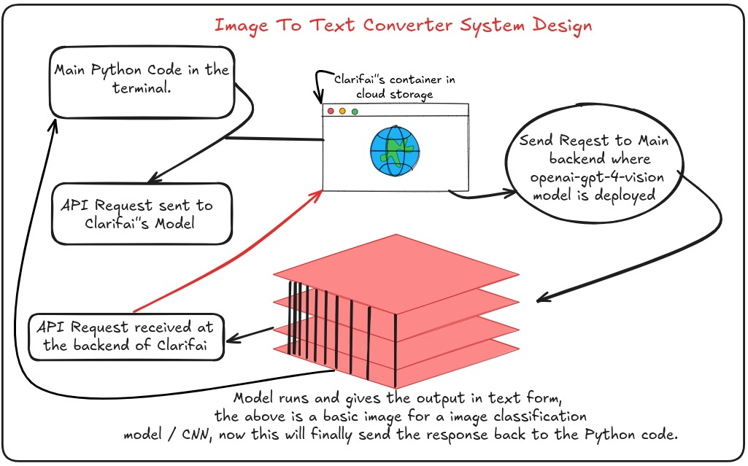
ARCHITECTURE DIAGRAM

Slide 14
TESTING
Test Case 1: Upload Valid Image
  Objective: Ensure the system accepts valid image files.
  Expected Result: The image is successfully uploaded, and the system proceeds to the preprocessing stage.
Test Case 2: Text Detection Accuracy
  Objective: Ensure text regions are accurately identified.
  Expected Result: The system correctly identifies all text regions and highlights them with bounding boxes.
Test Case 3: OCR Text Extraction
  Objective: Verify OCR extracts text accurately from detected regions.
  Expected Result: The system extracts text with over 90% accuracy.

Slide 15
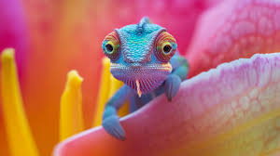
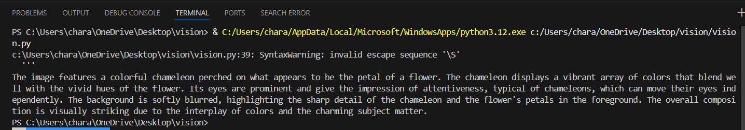
RESULTS

Slide 16
CONCLUSION AND FUTURE ENHANCEMENTS
CONCLUSION
The Image-to-Text Conversion Mini Project offers an efficient solution for extracting text from images, leveraging pre-processing techniques, feature extraction, and OCR to convert text into machine-readable formats. It automates tasks like document digitization, archival management, and real-time data processing, demonstrating robustness across varying image qualities and text types, including printed and handwritten content. With a user-friendly interface, it ensures accessibility for non-technical users. Future improvements, such as multilingual support, real-time processing, and enhanced handling of complex layouts, can further enhance its functionality, making it a valuable foundation for advanced text recognition systems.

Slide 17
CONCLUSION AND FUTURE ENHANCEMENTS
FUTURE ENHANCEMENTS
Text-to-Speech Conversion: Integrate functionality to convert extracted text into natural-sounding speech for accessibility and usability.
Mobile Application Development: Create a mobile app with features like offline text extraction, text-to-speech, and voice-to-text conversion.
Multilingual Support: Expand capabilities to include complex languages such as Arabic, Chinese, and Indic scripts with automatic language detection.
Real-Time Processing: Enable real-time text extraction from live video feeds and camera inputs on mobile devices.
AI-Driven Refinements: Incorporate grammar correction, spell-checking, and content classification for cleaner output.

Slide 18
THANK YOU

